Slide 1
HARDWARE PROJECT
----------------------------------------------------------------------------------------------------------------------
Created by
Information & Technology Department
Vatsal Chandrani & Hit Bhalodiya

Slide 2
A MOBILE BLUETOOTH CONTROLED SOLAR CAR
----------------------------------------------------------------------------------------------------------------------
FUTURE CONCEPT OF SOLAR CAR
A VISION TO MAKE THE AIR POLLUTION FREE
LEAST EXPENSIVE FUEL SYSTEM
CAN BE CONTROLED BY SINGLE CLICK OF YOUR MOBILE PHONE

Slide 3
Problems
Due to using of petroleum as a fuel, Our nature is getting polluted.
Due to pollution our health deteriorates.
In now days, the expenses of fuel is very high.
In the coming time, there will be shortage of fuel.
Solutions
This future concept of solar car can reduce the pollution.
There is almost zero cost of fuel to use it.
Good for our nature.
Advanced feature like controlled by your mobile phone app.

Slide 4
| OUTLINE
----------------------------------------------------------------------------------------------------------------------
Overview of project
3D Model of project
Future of this project
Limitations
Components
Diagrams and Figures
Arduino code
Advantage
Disadvantage
Preview

Slide 5
| OVERVIEW OF PROJECT
----------------------------------------------------------------------------------------------------------------------
In this project, we design a car whose roof is made by solar panels.
It is a very clear concept of using solar energy as a fuel.
In day time when you are driving the car, it will charge itself automatically by sunlight.
It can be controlled by your mobile phone.
In future, there will be a application of this car which will show you everything about your car.

Slide 6
There are three ways to do this project:
By Printed Circuit Board (PCB)
Here we use arduino UNO because it is easy to use, highly cost-effective and energy-efficient.
3 SYSTEMS OF A MOBILE BLUETOOTH CONTROLLED SOLAR CAR
By Radio Frequency Circuit Board (RF)
By Arduino UNO

Slide 7
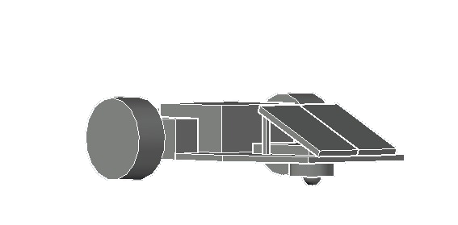
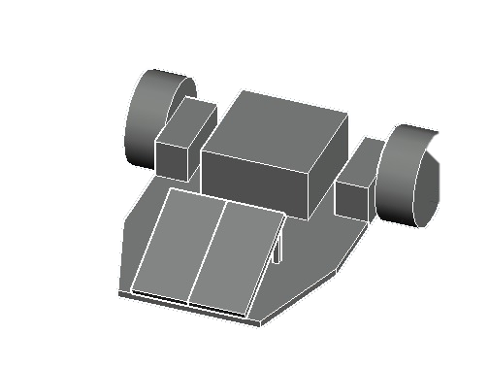
| 3D MODEL OF PROJECT
----------------------------------------------------------------------------------------------------------------------
This is the internal 3D model of car.
Here we use a caster 360 wheel instead of front wheels to give more focus on the solar system.
In future it will updated by front wheels.

Slide 8
| COMPONENTS
----------------------------------------------------------------------------------------------------------------------
Components which used in the project :
Arduino UNO
Motors
Motor driver modules
Bluetooth module
Solar cells
Caster-wheel for turning
Metal base of car
Jumper cables & wires

Slide 9
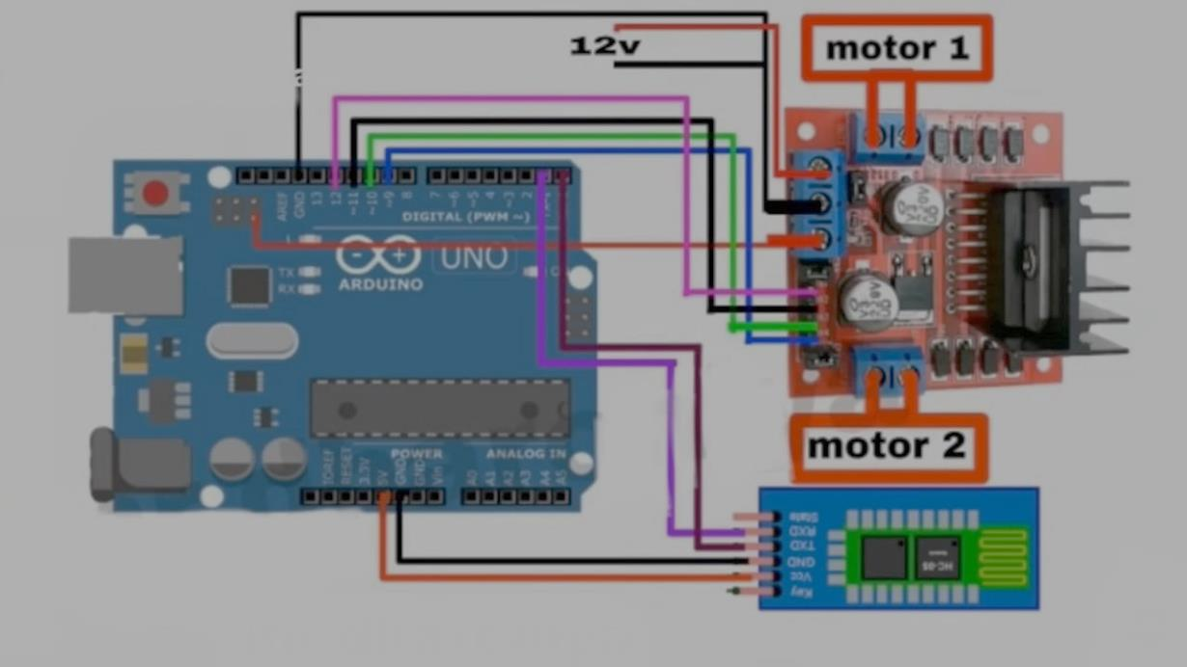
| DIAGRAMS AND FIGURES
----------------------------------------------------------------------------------------------------------------------
This is the circuit diagram of joints of arduino, motor-driver and Bluetooth module.
There is also a solar panel included in the project.
CIRCUIT DIAGRAM

Slide 10
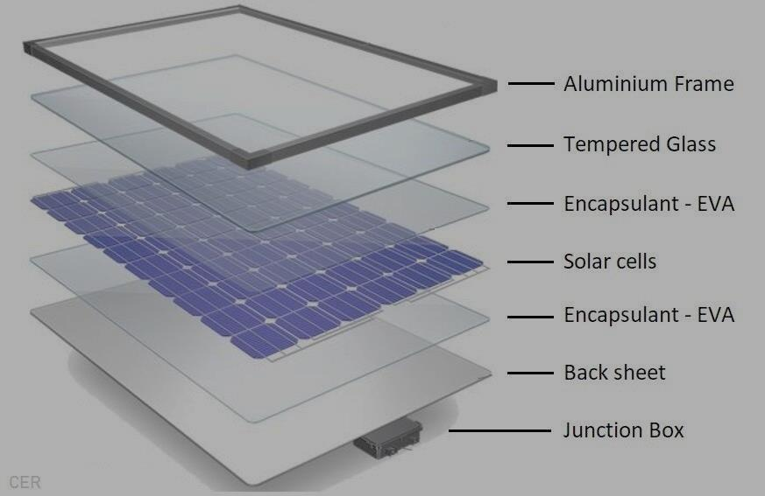
Solar panel/cells :
A photovoltaic (PV) cell, commonly called a solar cell, is a non-mechanical device that converts sunlight directly into electricity.
The PV cell is composed of semiconductor material.
A solar cell is a p-n junction diode in its most basic form.
It is a form of photoelectric cell, a device whose electrical characteristics vary when it is exposed to light.

Slide 11
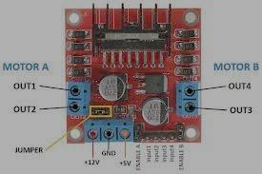
Motor Driver :
Motor Driver are basically current amplifiers followed by input signals.
There are three general categories of electric drives: DC motor drives, eddy current drives and AC motor drives.
Here we use L298N Motor driver module which is a DC motor driver.
Motor driver is used to control motion of a motor and its direction by feeding current accordingly.

Slide 12
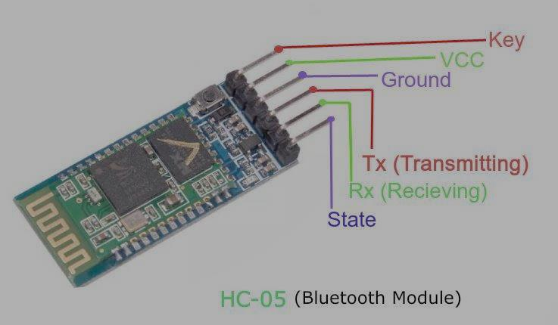
Bluetooth Module :
Bluetooth modules enable wireless audio connectivity between devices, here we use it to connect the mobile phones with your car via Bluetooth.
Here we use HC-05 Bluetooth Module.
A Bluetooth module is generally composed of PCB board, chip and peripheral components, and is used to replace data cable for small range wireless communication.

Slide 13
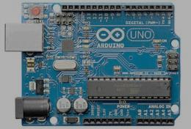
Arduino UNO :
Arduino is an open hardware development board that can be used by makers to design and built devices that interact with the real world.
Easy to use, highly cost-effective and energy-efficient.
It has 14 digital input/output pins.
6 can be used as PWM outputs
6 analog inputs
A 16MHz ceramic resonator
A USB connection
It has a power jack and an ICSP header and a reset button.

Slide 14
| ARDUINO CODE
----------------------------------------------------------------------------------------------------------------------
// Starting of Program
int m1a = 9;
int m1b = 10;
int m2a = 11;
int m2b = 12;
char val;
void setup()
{
pinMode(m1a, OUTPUT); // Digital pin 10 set as output Pin
pinMode(m1b, OUTPUT); // Digital pin 11 set as output Pin
pinMode(m2a, OUTPUT); // Digital pin 12 set as output Pin
pinMode(m2b, OUTPUT); // Digital pin 13 set as output Pin
Serial.begin(9600);
}

Slide 15
void loop(){
while (Serial.available() > 0)
{
val = Serial.read();
Serial.println(val);
}
if( val == 'F') // Forward
{
digitalWrite(m1a, HIGH);
digitalWrite(m1b, LOW);
digitalWrite(m2a, HIGH);
digitalWrite(m2b, LOW);
}
else if(val == 'B') // Backward
{
digitalWrite(m1a, LOW);
digitalWrite(m1b, HIGH);
digitalWrite(m2a, LOW);
digitalWrite(m2b, HIGH);
}

Slide 16
else if(val == 'L') //Left
{
digitalWrite(m1a, LOW);
digitalWrite(m1b, LOW);
digitalWrite(m2a, HIGH);
digitalWrite(m2b, LOW);
}
else if(val == 'R') //Right
{
digitalWrite(m1a, HIGH);
digitalWrite(m1b, LOW);
digitalWrite(m2a, LOW);
digitalWrite(m2b, LOW);
}
else if(val == 'S') //Stop
{
digitalWrite(m1a, LOW);
digitalWrite(m1b, LOW);
digitalWrite(m2a, LOW);
digitalWrite(m2b, LOW); }

Slide 17
else if(val == 'I') //Forward Right
{
digitalWrite(m1a, HIGH);
digitalWrite(m1b, LOW);
digitalWrite(m2a, LOW);
digitalWrite(m2b, LOW);
}
else if(val == 'J') //Backward Right
{
digitalWrite(m1a, LOW);
digitalWrite(m1b, HIGH);
digitalWrite(m2a, LOW);
digitalWrite(m2b, LOW);
}
else if(val == 'G') //Forward Left
{
digitalWrite(m1a, LOW);
digitalWrite(m1b, LOW);
digitalWrite(m2a, HIGH);
digitalWrite(m2b, LOW); }

Slide 18
else if(val == 'H') //Backward Left
{
digitalWrite(m1a, LOW);
digitalWrite(m1b, LOW);
digitalWrite(m2a, LOW);
digitalWrite(m2b, HIGH);
}
}
This code appears to be written in Arduino’s C/C++ programming language.
Above code is inserted in arduino by arduino code cable.
It designed to control a robotics vehicle’s movement based on serial input commands.
This code is help to move motors left, right, forward, backward and stop.

Slide 19
| LIMITATIONS
----------------------------------------------------------------------------------------------------------------------
The manufacturing cost is a bit expensive.
The main part of this project is solar cells and it required silicon chip as a raw material, but the silicon chip has created global supply chain issues across the tech industries.

Slide 20
| FUTURE OF PROJECT
----------------------------------------------------------------------------------------------------------------------
Our vision is to make a future concept car.
In future we will develop a application which has all information about your car.
It shows condition of the tires, state of your car engine.
It gives you information about battery’s condition.
It also give you a reminder about maintenance of solar panels.
We will try to make this

Slide 21
| ADVANTAGE
----------------------------------------------------------------------------------------------------------------------
POINTS | PETROLEUM VEHICLE | SOLAR VEHICLES
Environmental impact | It produce pollution and spoil the nature, a big reason of air pollution. | It is environmentally friendly, it has zero emission operation system.
Operating cost | It’s operating cost is expensive because of higher expenses of fuel. | It’s operating cost is cheaper, because you use the sun light as a fuel.
Quiet Operation | Petroleum car produce engine noise during operation and produce the noise pollution. | Solar cars operate silently, contributing to reduced noise pollution compared to petroleum cars.

Slide 22
| DISADVANTAGE
----------------------------------------------------------------------------------------------------------------------
POINTS | PETROLEUM VEHICLE | SOLAR VEHICLES
Manufacturing cost | It’s manufacturing cost is lower as compare to the solar car. | It’s manufacturing cost is higher then petroleum car.
Technology | This technology is working on the large scale. | There is not as much as awareness of this technology in now days.
Range and reliability | Petroleum cars generally offer a longer range and greater reliability in varying weather conditions compared to solar cars. | Solar cars may experience limitations in low-light or adverse weather conditions.

Slide 23
| PREVIEW
----------------------------------------------------------------------------------------------------------------------
Overall, while solar cars offer environmental benefits and use renewable energy, they currently face limitations in range, performance, and infrastructure compared to petroleum cars.
However, advancements in technology and infrastructure may improve the feasibility and adoption of solar-powered vehicles in the future.

Slide 24
Thank you for your attention…
----------------------------------------------------------------------------------------------------------------------

